Slide 1
Proof-of-Concept (POC) Pilot NCI Finding Cancer Trials Collaborative (FCTC)
Structuring Eligibility Criteria Via NCI Enterprise Vocabulary Services (EVS) Terminology and Logical Expressions

Slide 2
Potential Uses for AI/NLP in Patient/Trial Matching
Matching patients to trials: Match patients to trials based on eligibility criteria/patient information (and vice versa).
Standardized protocol templates: Take text (and/or structured eligibility criteria) and cluster to find templates that can be used to in future to standardize protocols when they are initially written for a trial.
Curator assistant: Take text from new trials as they are submitted to CTRP and convert suggestions to CTRP abstractors via NLP. These could automatically help identify and sort on criteria, extract concepts and map to ontology, and determine logic. This can make Structured Eligibility Criteria (after trial submitted) more scalable.
Chatbots: Use protocol text/structured eligibility criteria for engaging patients looking for trials.

Slide 3
Introduction

Slide 4
Introduction

Slide 5
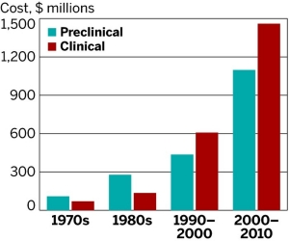
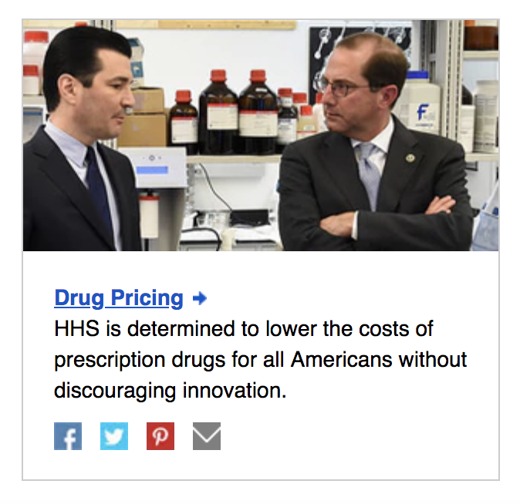
“Unless clinical trial cycle time (and therefore costs) can be reduced, it’s fair to say that it is all but impossible to reduce drug development costs, and, therefore, prescription drug prices.” - Barry Lake, CEO, Devana Solutions
Drug development costs increasing
One of Top 4 HHS Priorities: Drug Pricing
P R E S I D E N T I A L I N N O V A T I O N F E L L O W S | pif.gov | @innovfellows
Notes:
I’m going to break this slide down for you because we have a few things going on

Slide 6
Introduction

Slide 7
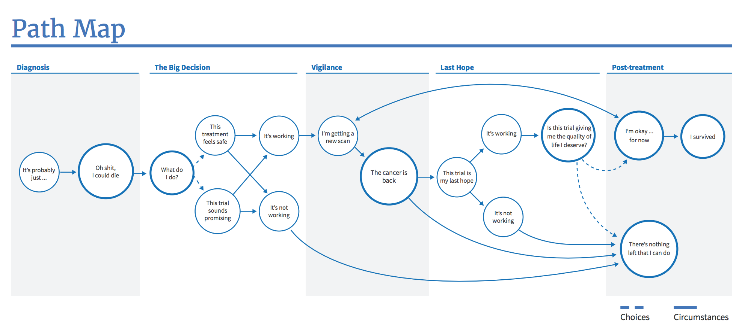

Slide 8

The goal of the patient is not to go through a clinical trial; their goal is to get better.

Slide 9
Toward Matching Patients with Clinical Trials (and Vice Versa):
Patients Needing Trials
Clinical Trials Needing Patients
Medical Record, Registry, etc
Clinical/ Cancer Trials Database
Match?
Individual patient data
Clinical/ Cancer Trial Protocols

Slide 10
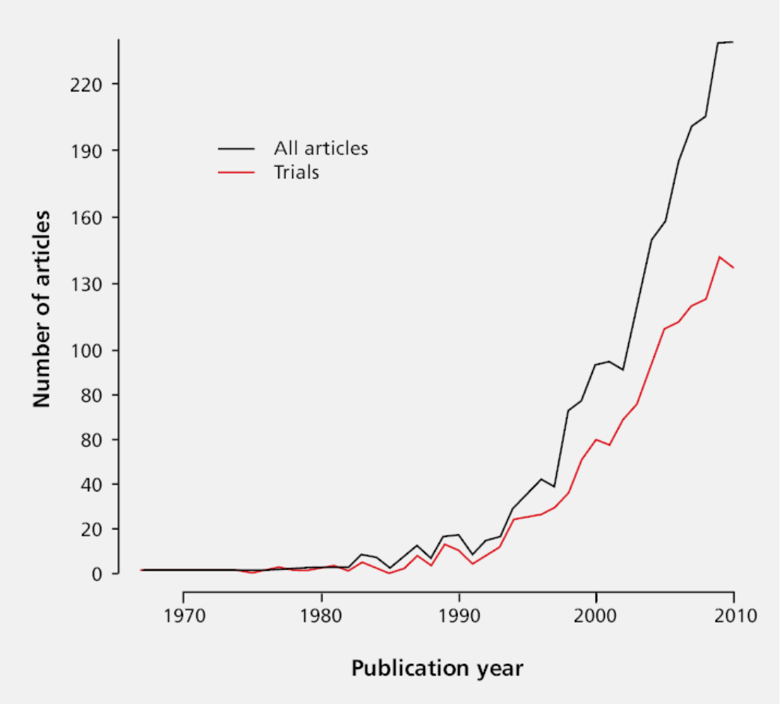
Problem:
Patients, researchers, caregivers, physicians are all overwhelmed by the amount of information (data) they need to search through to find the right therapy.
P R E S I D E N T I A L I N N O V A T I O N F E L L O W S | pif.gov | @innovfellows
Notes:
NCI, ClinicalTrials.gov have all set up contact centers for helping with this problem, and researchers are paying IBM, Microsoft, Google, and many other companies millions of dollars to search for the signal within the noise of available trials, medical record, and research data.

Slide 11
Eligibility Criteria
Inclusion Criteria:
For pre-surgical patients
Suspected diagnosis of resectable non-small cell lung cancer; cancers with a histology of "adenosquamous" are considered a type of adenocarcinoma and thus a "nonsquamous" histology; patients with squamous cell carcinoma are eligible only if the registering site has EA5142 Institutional Review Board (IRB) approved
Suspected clinical stage of IIIA, II (IIA or IIB) or large IB (defined as size >= 4cm); Note: IB tumors < 4cm are NOT eligible; stage IB cancer based on pleural invasion is not eligible unless the tumor size is >= 4cm
For post-surgical patients
Completely resected non-small cell lung cancer with negative margins (R0); patients with squamous cell carcinoma are eligible only if the registering site has EA5142 IRB approved
Pathologic stage IIIA, II (IIA or IIB) or large IB (defined as size >= 4 cm); Note: IB tumors < 4cm are NOT eligible; stage IB cancer based on pleural invasion is not eligible unless the tumor size is >= 4cm
Eastern Cooperative Oncology Group (ECOG) performance status 0-1
No patients who have received neoadjuvant therapy (chemo- or radio-therapy) for this lung cancer
No locally advanced or metastatic cancer requiring systemic therapy within 5 years prior to registration; no secondary primary lung cancer diagnosed concurrently or within 2 year prior to registration
No prior treatment with agents targeting EGFR mutation, ALK rearrangement, and PD-1/PD-L1/CTLA-4
No patients known to be pregnant or lactating
Patients who have had local genotyping are eligible, regardless of the local result
No patients with recurrence of lung cancer after prior resection
Note: Post-surgical patients should proceed to registration immediately following preregistration
Completely resected NSCLC with negative margins (R0); cancers with a histology of "adenosquamous" are considered a type of adenocarcinoma and thus a "nonsquamous" histology; patients with squamous cell carcinoma are eligible only if the registering site has EA5142 IRB approved
Pathologic stage IIIA, IIA or IIB, or large IB (defined as size >= 4cm); Note: IB tumors < 4cm are NOT eligible; stage IB cancer based on pleural invasion is not eligible unless the tumor size is >= 4cm
Tissue available for the required analyses (either clinical tissue block or slides and scrolls)
In order to allow for time for central genotyping and eligibility for the ALCHEMIST treatment trial, patients must register within the following eligibility windows, depending on the adjuvant treatment approach:
If no adjuvant therapy, register patient within 75 days following surgery
If adjuvant chemotherapy or radiotherapy only, register patient within 225 days following surgery
If adjuvant chemotherapy and radiation, register patient within 285 days following surgery

Slide 12

AI/Machine Learning:
A viable solution to the problems of searching and interpreting vast amounts of heterogeneous data.

Slide 13


Natural language processing (NLP) is a machine learning approach to structuring text to make it easier for computers to process.

Slide 14
Need clarity and uniformity to facilitate NLP/AI
Eligibility language is not structured
Eligibility language is complex: text can be confusing for humans (and machines)
Eligibility language is not standardized

Slide 15
Potential Uses for AI/NLP in Patient/Trial Matching
Matching patients to trials: Match patients to trials based on eligibility criteria/patient information (and vice versa).
Standardized protocol templates: Take text (and/or structured eligibility criteria) and cluster to find templates that can be used to in future to standardize protocols when they are initially written for a trial.
Curator assistant: Take text from new trials as they are submitted to CTRP and convert suggestions to CTRP abstractors via NLP. These could automatically help identify and sort on criteria, extract concepts and map to ontology, and determine logic. This can make Structured Eligibility Criteria (after trial submitted) more scalable.
Chatbots: Use protocol text/structured eligibility criteria for engaging patients looking for trials.

Slide 16
Example of Similar Criteria
70% of time (hypothetical):
Inclusion: Platelet count greater than or equal to 100000 platelets per cubic milimeter
10% of time:
Inclusion: Platelet count greater than or equal to 100000 platelets per cubic milimeter without transfusion
10% of time:
Inclusion: Platelet count greater than or equal to 75000 platelets per cubic milimeter
10% of time:
Other…

Slide 17
Example with Platelets
Criteria, concept, logic
Platelet > 100000/mm^3
Template
Platelet count greater than or equal to YYY platelets per cubic milimeter without transfusion
Standardized protocol
Platelet count greater than or equal to min. platelets per cubic milimeter (where min. is standardized to 100000)

Slide 18
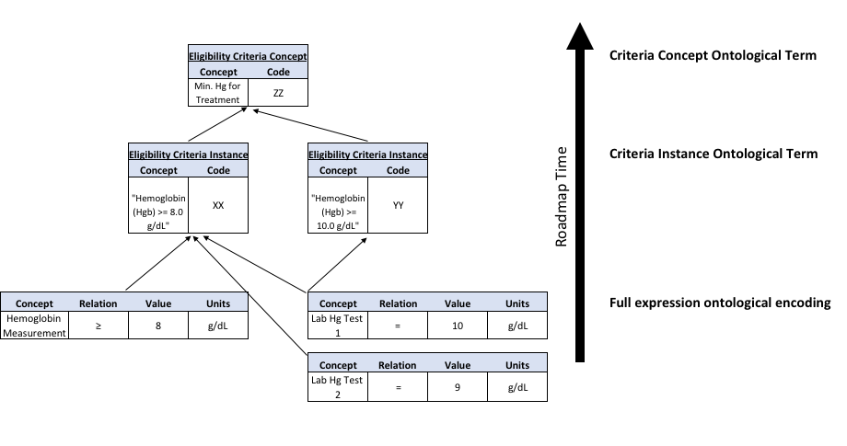
Hybrid Ontology Approach
Standardized protocol
Templates
Criteria, Logic,
Concepts
Hybrid ontology enables capturing protocol concepts and instances as well as reasoning over observed instances (e.g. lab results)

Slide 19
NIH Data Hackathon Goal: Toward Structured Protocol Standards and Templates
AI for Structured Protocol Standards
Load in hemoglobin criteria text (e.g. all 342 CTEP ECTN trials).
Cluster based on similarity (e.g. semantics/entity/logical expression) to find patterns.
Extract popular templates with options for curators to select from (with frequency of popularity).

Slide 20
Datasets
Previous
Plain text (e.g. cancer clinical trial database: clinicaltrialsapi.cancer.gov); Trinary values: e.g. Ineligible (unconditional), eligible, indeterminate
Current
Structured logical expressions for:
Eligibility criteria for white blood cell count, hemoglobin, platelets, HIV
Participant instance data from contact center calls for clinical trials
Future
Patient-trial match ratings

Slide 21
NIH Data Hackathon
Topic: Use machine learning to find patterns of similar eligibility protocol criteria for clinical trials
3 days: July 23-25, Board of Regents Room. Building 38, NIH Campus
Facilitated/coordinated by NLM/NCBI
Critical background info and datasets are at the Github for participants via NLM/NCBI hackathon site: https://github.com/NCBI-Hackathons/CTEligible
Webinar 12-1p: https://tinyurl.com/y6v2ea5f
Directions: NLM Board of Regents (Lindberg) Room. It is in NIH main campus building 38 (the short building across the street from Natcher, in front of 38A). If you go in the main entrance to building 38, there is a staircase on your right that goes straight up to the room.

Slide 22
Schedule for July 2018 NIH Data Hackathon
Monday, July 23rd
9:00-9:30: Introductions, Administrative Announcements and Building Functional Software
9:45 - 10:00: Technical considerations
9:45 - 10:00: Role assignments in teams
10:00 - 12:00: Sysadmins and Data Acquisition get data, if necessary. Work on first sketch of plan (one page google doc, or similar)
12:00 - 12:30 (part 1): Working lunch with AI/NLP presentation by Dr. Gil Alterovitz
12:30 – 1:00 (part 2): AI/NLP presentation by Dr. Gil Alterovitz (not for local partipants)
1:00 - 6:30: Script building. Goal for AI for precision cancer trial matching track: use machine learning to find patterns of similar eligibility protocol criteria for clinical trials.
6:30 - 7:30: DINNER (on your own or with group members)
7:30 - 8:30: Script building

Slide 23
Tuesday, July 24th
9:00 - 9:15: Introduction to day/current status
9:15 - 12:30: Data cleanup, code fixing, and presentation generation
12:30 - 1:30 Working lunch. Each section presents three to four slides; opportunity for exchange of ideas
1:30 - 6:00: Scripts fixing and implementing suggestions from other group; more data runs
3:00 - 4:00 Writer’s group break off
6:30 - 8:30: GROUP DINNER @ A local restaurant opportunity for feedback on organizational structure and future projects

Slide 24
Wednesday, July 25th
8:30: Breakfast provided by Ben Busby. More opportunity for feedback on organizational structure and future work
9:00 - 12:00: Finishing scripts/pipelines
12:40 - 1:10: Working lunch
3:10 - 3:40: Work on writing documentation/README, results, presentations. Testing/bug fixes.
5:00 - 5:15: Communications, community interaction, and longevity of code
5:15 - 6:30: Final Presentations

Slide 25
Proof-of-Concept Pilot: Testing the Hypothesis
Data Set 1
“Trials”
Computer runs “script” to Match Patient Data with Trial Data
Data Set 2
“Patients”
Structured Eligibility Open NCTN Trials N=~360
Structured patient characteristics N=~100
Patient Trial Matches “Output”
Compare computer generated list with expert ranking lists
Data Set 3
“Ranked Trials”
Expert ranked list of trials for each of the patients in Dataset 2 from Dataset 1
Comparison Results
% agreement
“Output”
1

Slide 26
Structuring Criteria Using EVS Terminology and Boolean Logic
Data Set 1: Eligibility Criteria
Source: Clinical Trials Reporting Program) CTRP trials from 342 trials (2009 to 2017)
Type: NCI Enterprise Vocabulary Services (EVS) coded data, Boolean expressions
Data Set 2: Patient Data
Source: 100 Contact center phone calls
Type: EVS coded data (Boolean)
Data Set 3: Search Rankings
Source: Expert curation of trial search results
Type: Rankings
Status: TBD

Slide 27
Dataset 1: Eligibility Criteria
HIV, Hemoglobin, Platelets, and White blood cell count

Slide 28
Structuring Eligibility – Example: HIV Criterion with NCI Thes. Terms
Patients with active human immunodeficiency virus (HIV) infection are eligible [for the clinical trial] if their cluster of differentiation (CD)4 count is > 499/mm³ and their viral load is < 50 copies/ml; use of antiretroviral treatment (HAART) is allowed
Hybrid Ontology Approach: Level 1 (High detection, some false matches)
HIV Positive
Level 2 (High detection, additional manual matching needed)
HIV positive AND additional criteria…
Note: Implied that HIV Negative also a match

Slide 29
Structuring Eligibility – Example: HIV Criterion with NCI thes. Terms
Patients with active human immunodeficiency virus (HIV) infection are eligible [for the clinical trial] if their cluster of differentiation (CD)4 count is > 499/mm³ and their viral load is < 50 copies/ml; use of antiretroviral treatment (HAART) is allowed
Level 3 (Boolean representation) HIV Negative OR (HIV positive AND active AND infection AND CD4 > 499/mm3 AND viral load < 50 copies/ml AND HAART = YES)
(C15175 = NO) OR ((C15175 = YES) AND ((C45329 = YES) AND (C128320 = YES)) AND (C103810 >499 cell/mm3) AND (C51952 < 50 copies/ml) AND (C16165 = YES))
Notes:
Level 4 (Time Context): Additional time-based information

Slide 30
Dataset 2: Patient Data
Cancer Site (Primary), Cancer Type, Stage, Cell Type, Grade, State/Institution/City, Zipcode, Type of Trial, Treatment History

Slide 31
People
Wendy Harman
Candace Maynard
Neesha Desai
Mary Anne Bright
Sheila Prindiville
Peter Garrett
Tony Kerlavage + many others
Gil Alterovitz
Justin Koufopoulos
Alvin Salehi
Jerry Sheehan
Sam Isa
Shahin Assefnia
Gisele Sarosy
David Loose
Brent Coffey
David Patton
Samantha Finstad
Nina Bianchi
NIH/NCI/NLM point of contacts: Gil Alterovitz gil.alterovitz@pif.gov Justin Koufopoulos justin.koufopoulos@pif.gov

